Slide 1

Building the Real-time Web with ASP.NET Core SignalR
Scott Addie
Senior Content Developer
@Scott_Addie

Slide 2


SignalR overview
Real-time web app model in ASP.NET Core
SignalR client
SignalR connection (WebSockets)
SignalR server (ASP.NET Core)
.NET, JS, Java

Slide 3
Architectural components: Hubs
C# class containing public methods the client can invoke
Each Hub is mapped to a URL
Startup.cs
public class Startup { private string _connection = null; public Startup(IConfiguration configuration) => Configuration = configuration; public IConfiguration Configuration { get; } public void ConfigureServices(IServiceCollection services) { var builder = new SqlConnectionStringBuilder( Configuration.GetConnectionString("Movies")); builder.UserID = Configuration["Movies:User"]; builder.Password = Configuration["Movies:Password"]; _connection = builder.ConnectionString;

Slide 4
SignalR clients
.NET client
NuGet package:
Microsoft.AspNetCore.SignalR.Client
TypeScript / JavaScript client
npm package:
npm install @aspnet/signalr
CDN:
libman install @aspnet/signalr -p unpkg -d wwwroot/lib/signalr --files dist/browser/signalr.js --files dist/browser/signalr.min.js
Notes:
UI support for LibMan as of VS 2017 15.8

Slide 5
Scale-out with SignalR
Necessity with a server farm
Actions on 1 server need to be known to other servers
Azure SignalR Service or Redis
Redis
Notes:
SQL Server not an option, as it as in ASP.NET 4.x

Slide 6
Create an ASP.NET Core SignalR app
Demo

Slide 7

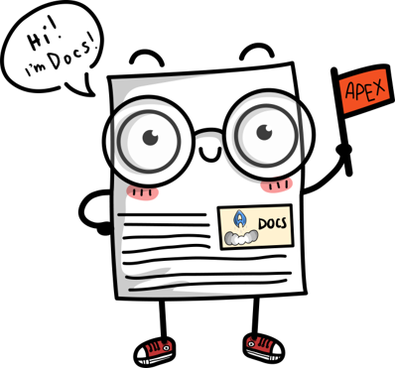
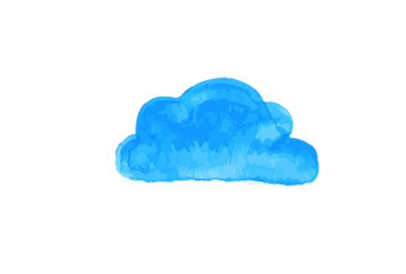
Resources @Scott_Addie
Docs
Slides
Sample Apps
➔
docs.microsoft.com/aspnet/core/signalr
➔
docs.microsoft.com/azure/azure-signalr
➔
aka.ms/aspnet-devops-slides
➔
github.com/aspnet/SignalR-samples

Slide 8

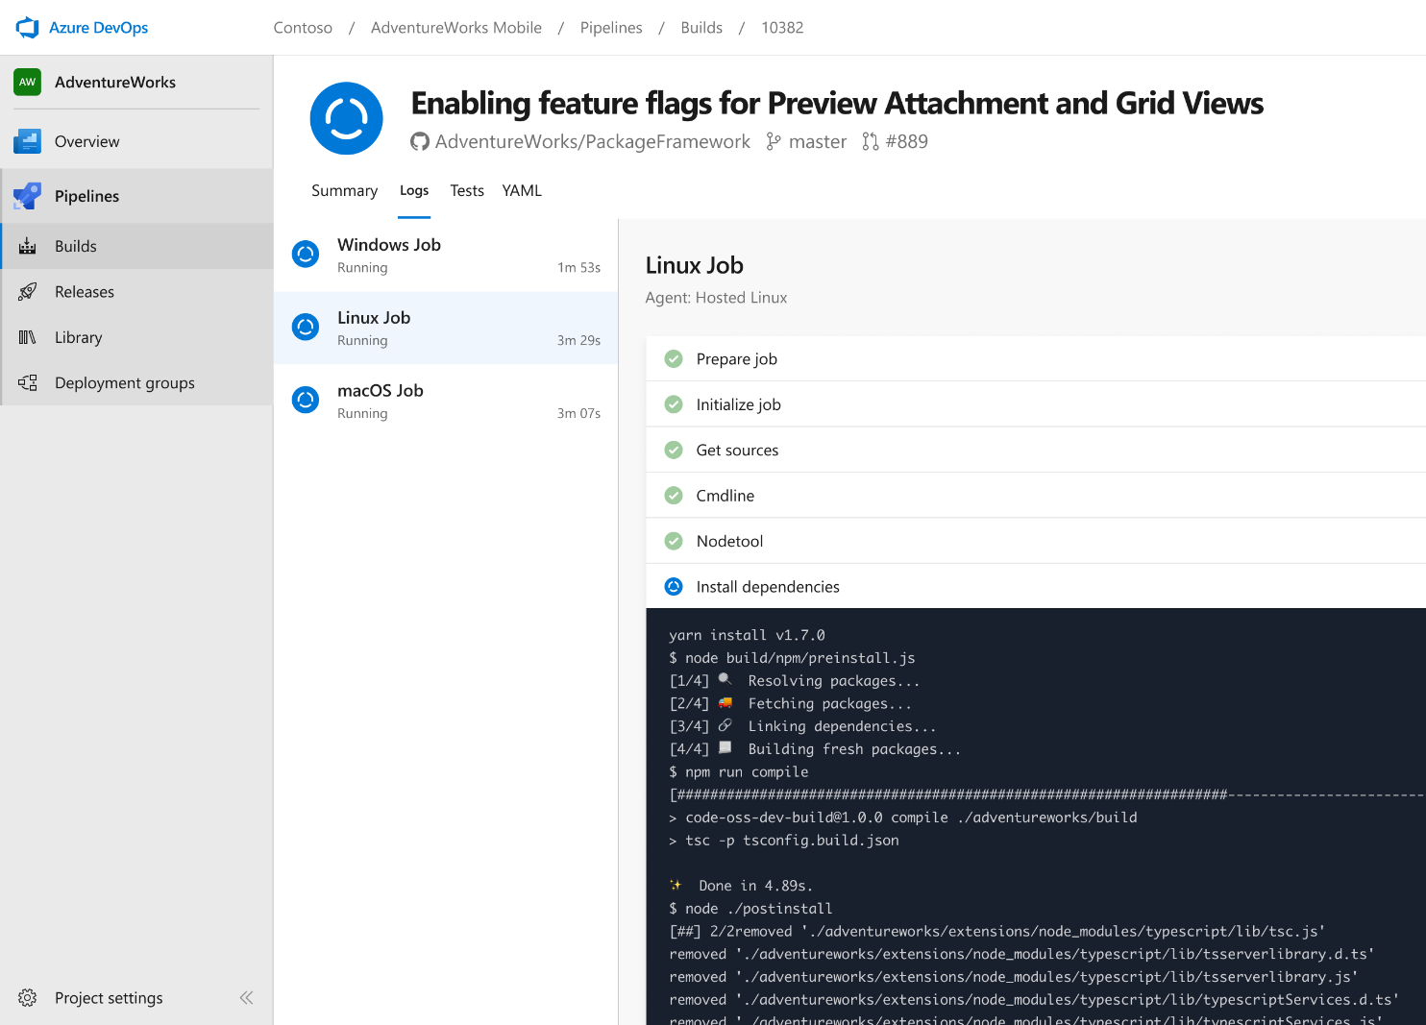


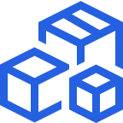

Azure Pipelines
Cloud-hosted pipelines for Linux, Windows and macOS, with unlimited minutes for open source
Any language, any platform, any cloud
Build, test, and deploy Node.js, Python, Java, PHP, Ruby, C/C++, .NET, Android, and iOS apps. Run in parallel on Linux, macOS, and Windows. Deploy to Azure, AWS, GCP or on-premises
Extensible
Explore and implement a wide range of community-built build, test, and deployment tasks, along with hundreds of extensions from Slack to SonarCloud. Support for YAML, reporting and more
Containers and Kubernetes
Easily build and push images to container registries like Docker Hub and Azure Container Registry. Deploy containers to individual hosts or Kubernetes.
Best-in-class for open source
Ensure fast continuous integration/continuous delivery (CI/CD) pipelines for every open source project. Get unlimited build minutes for all open source projects with up to 10 free parallel jobs across Linux, macOS and Windows
➔
https://azure.com/pipelines
Notes:
Azure Pipelines is the perfect launchpad for your code – automating your builds and deployments so you spend less time with the nuts and bolts and more time being creative

Slide 9

“Judge us by the actions we have taken in the recent past, our actions today and in the future”
—Satya Nadella, CEO Microsoft
2012
2018

Slide 10
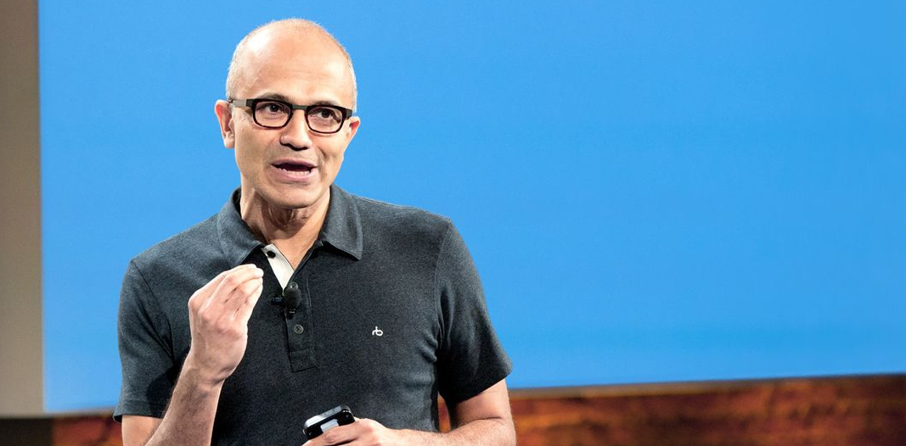

Microsoft Open Source
2018
Visual Studio Code ranked #1 developer tool
Azure Service Fabric Open Sourced
Azure Sphere with Linux kernel
Intent to acquire GitHub announced
~5,000 Microsoft employees committing to open source projects on GitHub
Azure trending to 50% Linux
Microsoft continues as largest contributor to open source projects on GitHub
“Judge us by the actions we have taken in the recent past, our actions today and in the future”
—Satya Nadella, CEO Microsoft
2017
Microsoft Azure Kubernetes Service launched
Draft, Brigade, Kashti projects submitted to Kubernetes community
Microsoft joins Cloud Native Computing & Cloud Foundry Foundations
SQL 2017 on Linux
Windows source code moved to Git
Azure Databricks (Apache Spark) announced
2016
.NET Core 1.0
PowerShell Core
Windows Subsystem for Linux in Windows 10
Microsoft joins Linux Foundation
GitHub recognizes Microsoft as a top open source contributor
2015
Visual Studio Code released
HDInsight (Hadoop/ Ubuntu) announced
Microsoft jointly forms Node.js foundation
2014
Satya “Microsoft loves Linux”
Microsoft org on GitHub created
.NET Foundation created
2012
TypeScript released
Git support added to TFS and Visual Studio
2012
2014
2015
2016
2017
2018
Notes:
& at Microsoft we love open source.
Every year we do more & more in the open source realm.
How we embrace the projects the community has embraced… from Linux to Kubernetes.
One of the ones I was deeply involved in was whether to compete with Git or become part of it. Today most of MS development is done in Git. The source control system that Linux created.
Including Windows. Think about that for a second, the Windows team use the source control system written by Linus Torvalds.
Or the ways we increasingly open source the software we work on… from .NET to VS Code & TypeScript. In fact, much of the core tech in Azure Pipelines itself is open source
Transition:
This week we are adding to this list…
Backup:
First OSS project was in 2004 when the Windows Installer Toolkit (WiX) was released to SourceForge.
Started contributing to the Linux kernel in 2009

Slide 11

Azure Pipelines
Microsoft Open Source
Free unlimited build minutes for public projects
Up to 10 free parallel jobs across Windows, Linux and macOS
➔
https://azure.com/pipelines
Notes:
All the builds you need, using the power of Azure you get one service that gives you unlimited build minutes where you can build on Windows Mac and Linux in parallel using a single build YAML file.

Slide 12

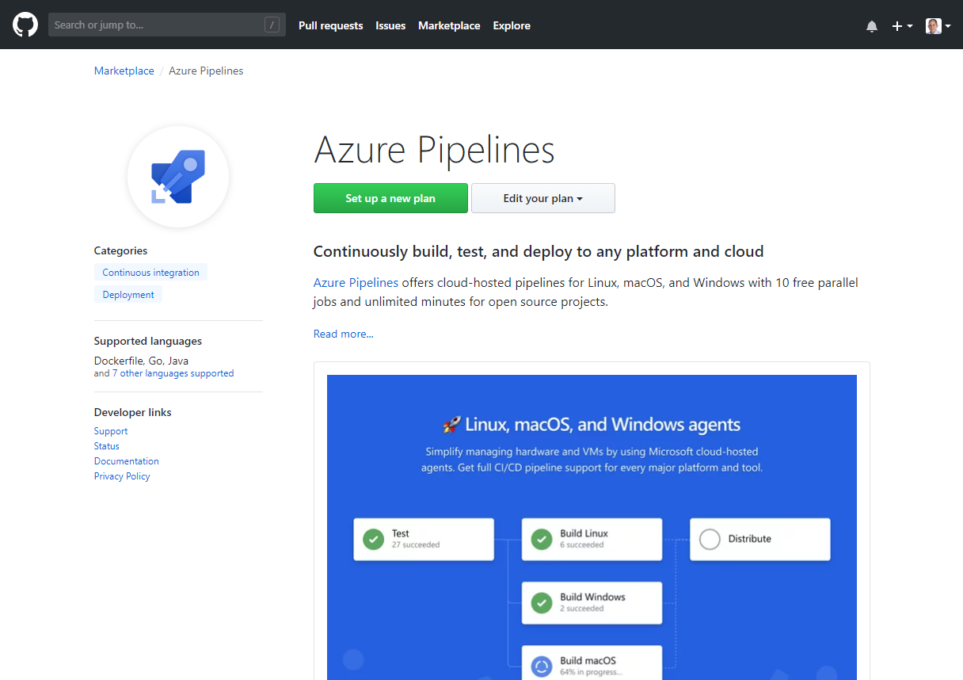
Integrated with GitHub
Azure Pipelines available now to any developer from the GitHub Marketplace

Slide 13





Azure DevOps
Azure Boards
Azure Pipelines
Azure Repos
Deliver value to your users faster using proven agile tools to plan, track, and discuss work across your teams.
Build, test, and deploy with CI/CD that works with any language, platform, and cloud. Connect to GitHub or any other Git provider and deploy continuously.
Get unlimited, cloud-hosted private Git repos and collaborate to build better code with pull requests and advanced file management.
Azure Test Plans
Azure Artifacts
➔
Test and ship with confidence using manual and exploratory testing tools.
Create, host, and share packages with your team, and add artifacts to your CI/CD pipelines with a single click.
https://azure.com/devops
Notes:
So does TFS

Slide 14

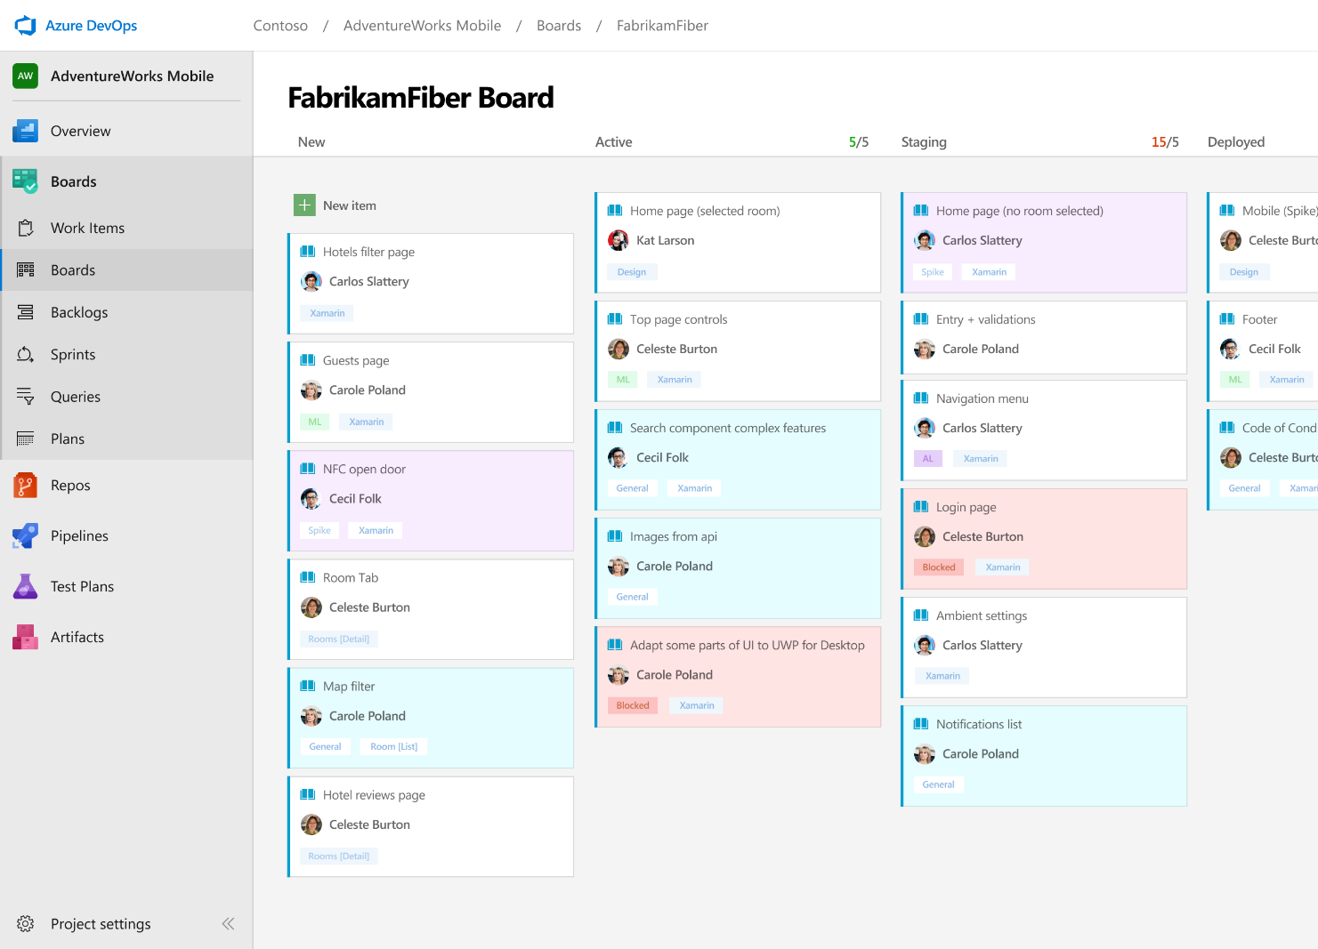



Azure Boards
Track work with Kanban boards, backlogs, team dashboards, and custom reporting
Connected from idea to release
Track all your ideas at every development stage and keep your team aligned with all code changes linked directly to work items.
Scrum ready
Use built-in scrum boards and planning tools to help your teams run sprints, stand-ups, and planning meetings.
Project insights
Gain new insights into the health and status of your project with powerful analytics tools and dashboard widgets.
➔
https://azure.com/devops
Notes:
Combine Kanban boards and drag-and-drop sprint planning with comprehensive traceability and reporting for the perfect home for all your ideas–big and small.

Slide 15
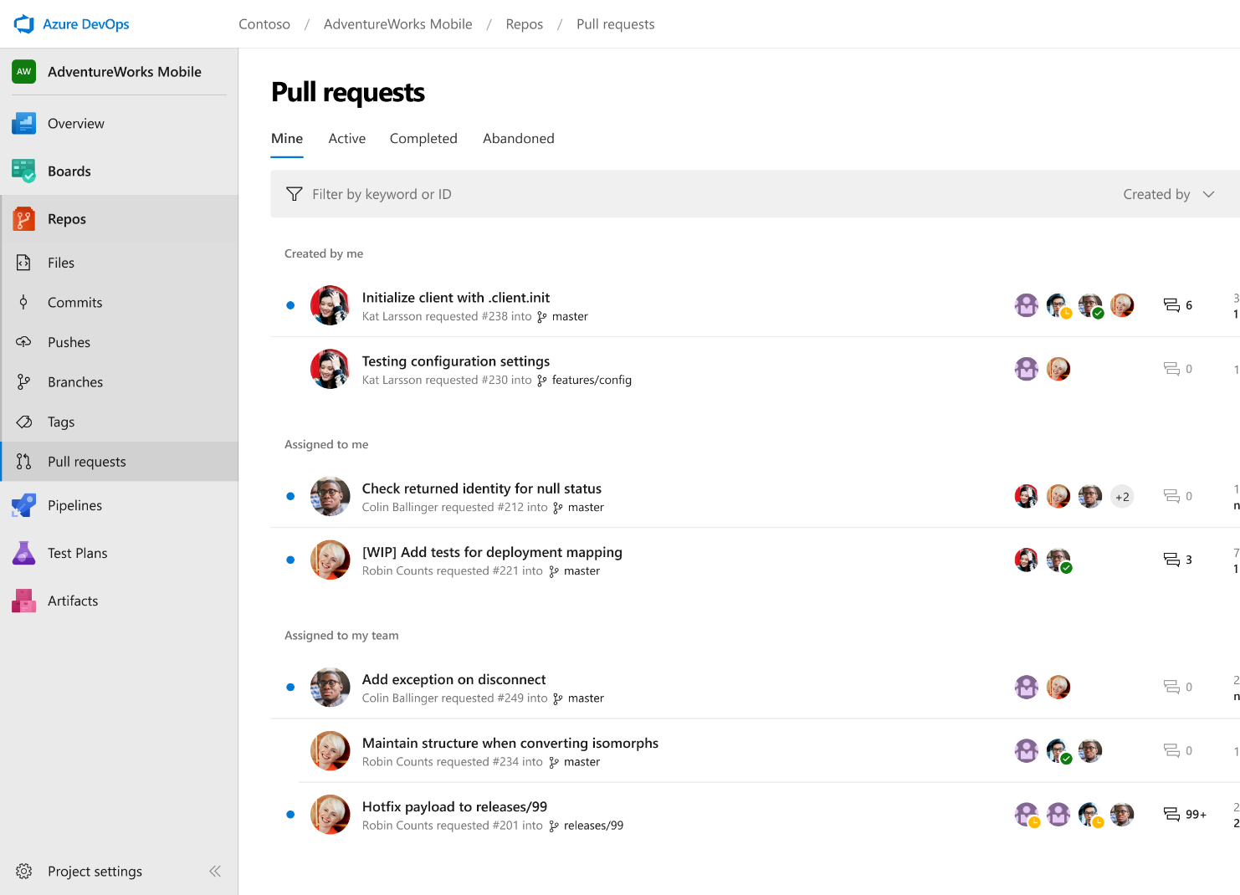



Azure Repos
Unlimited private Git repo hosting and support for TFVC that scales from a hobby project to the world’s largest Git repositories
Works with your Git client
Securely connect with and push code into your Git repos from any IDE, editor, or Git client.
Web hooks and API integration
Add validations and extensions from the marketplace or build your own using web hooks and REST APIs.
Semantic code search
Quickly find what you’re looking for with code-aware search that understands classes and variables.
➔
https://azure.com/devops
Notes:
Collaborate on code changes with threaded discussion and continuous integration for each change. Use forks to promote collaboration with Inner Source workflows.

Slide 16
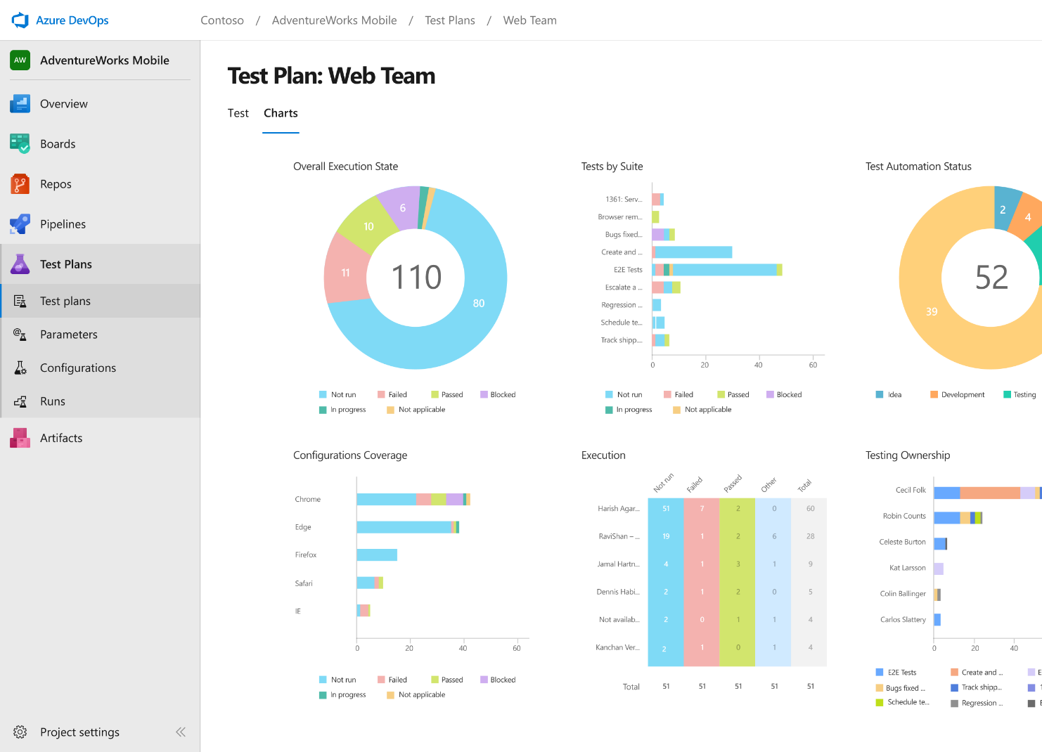
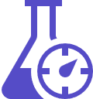


Azure Test Plans
Get end-to-end traceability. Run tests and log defects from your browser. Track and assess quality throughout your testing lifecycle.
Capture rich data
Capture rich scenario data as you execute tests to make discovered defects actionable. Explore user stories without test cases or test steps. You can create test cases directly from your exploratory test sessions.
Test across web and desktop
Test your application where it lives. Complete scripted tests across desktop or web scenarios. Test on-premises application from the cloud and vice-versa.
Get end-to-end traceability
Leverage the same test tools across your engineers and user acceptance testing stakeholders. Pay for the tools only when you need them.
➔
https://azure.com/devops
Notes:
Collaborate on code changes with threaded discussion and continuous integration for each change. Use forks to promote collaboration with Inner Source workflows.

Slide 17
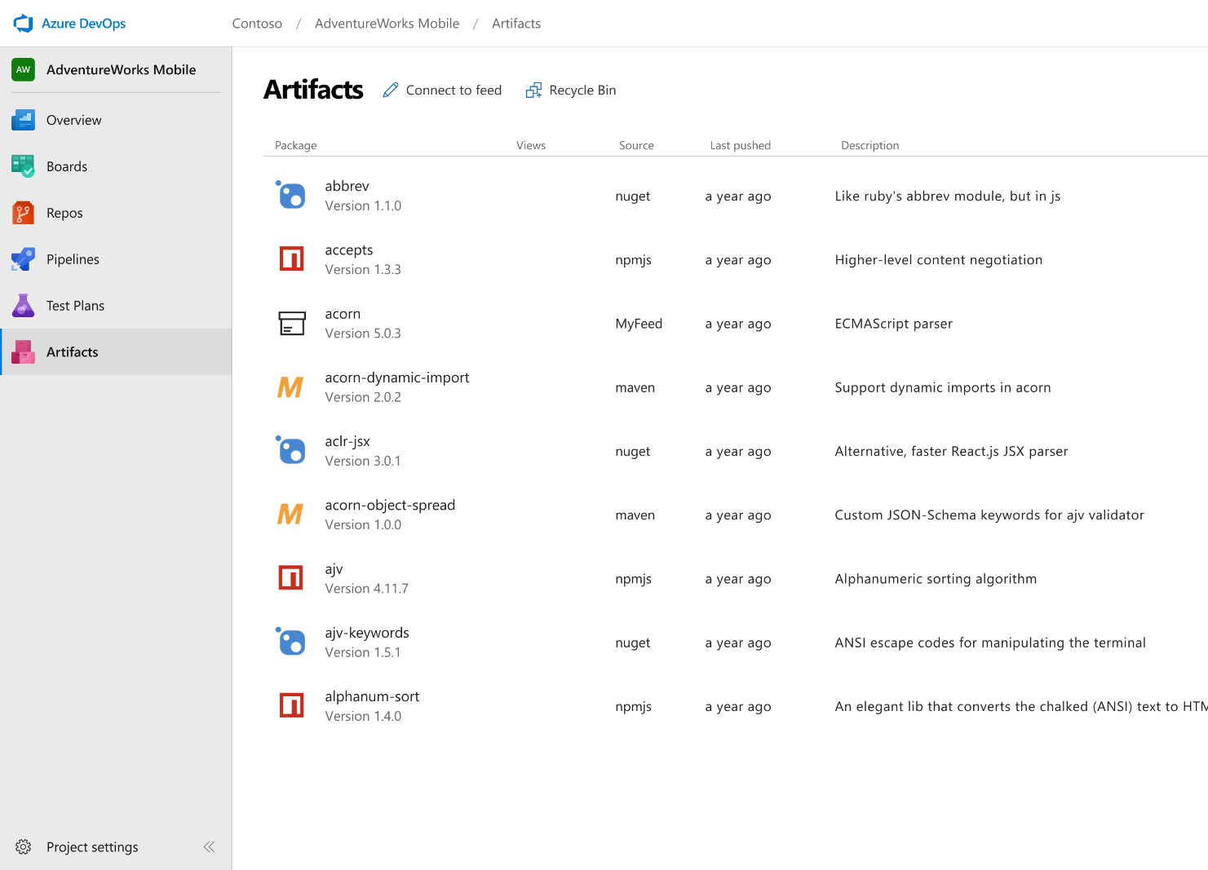



Azure Artifacts
Create and share Maven, npm, and NuGet package feeds from public and private sources – fully integrated into CI/CD pipelines
Manage all package types
Get universal artifact management for Maven, npm, and NuGet.
Add packages to any pipeline
Share packages, and use built-in CI/CD, versioning, and testing.
Share code efficiently
Easily share code across small teams and large enterprises.
➔
https://azure.com/devops
Notes:
Collaborate on code changes with threaded discussion and continuous integration for each change. Use forks to promote collaboration with Inner Source workflows.

Slide 18
Azure DevOps
#AzureDevOps
Demo
Speaker Name

Slide 19
Azure DevOps
Better together
Azure Boards
Azure Repos
Azure Pipelines
Azure Test Plans
Azure Artifacts
An end-to-end solution for organizations looking for an enterprise-grade toolchain
Fully Integrated with end to end traceability
Scalable to any team and project size
Highly available, multi region, hybrid cloud & on-prem
Customer Support
Consistent admin and access control
➔
https://azure.com/devops

Slide 20






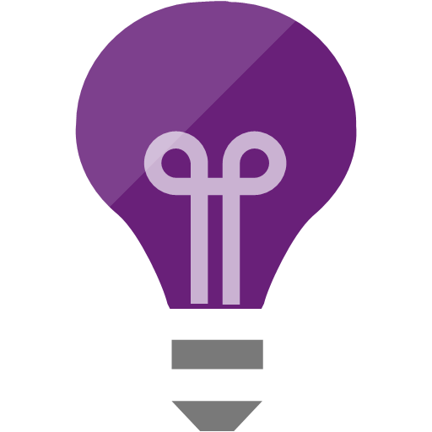

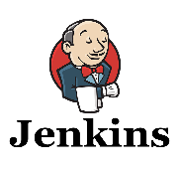
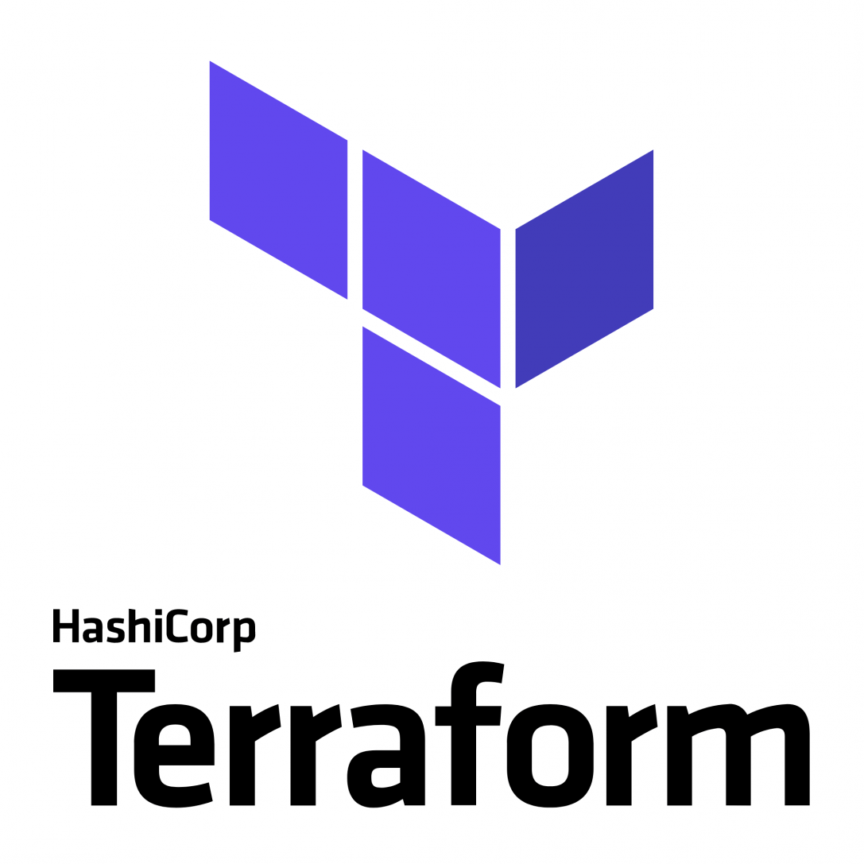
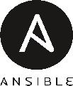


Broadening the Azure Ecosystem
Notes:
So does TFS

Slide 21

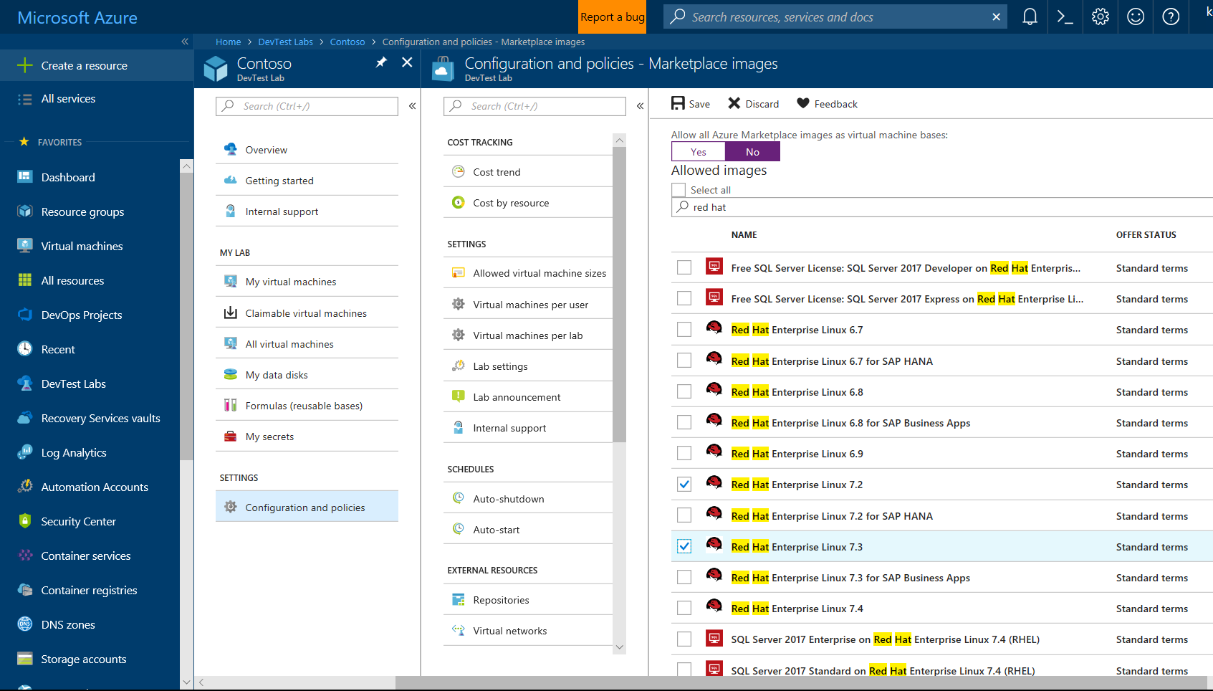
Self-Service Dev/Test Environments
Azure Lab Services
Simplify cloud environment management for developers and testers.
Enforce policies and control costs with full visibility
Use templates, custom images and formulas to reproduce environments.
Orchestrate with Azure Pipelines or integrate using REST API
Notes:
Whether you’ve already started implementing DevOps or looking to get started, a common challenge is for IT organizations is keeping up with project demand for development and test environments
DevTest Labs simplifies environment management for Dev & Test environments in the Azure cloud
Provide self-service access for teams, with policies to control cost and enforce use of appropriate images and artifacts

Slide 22
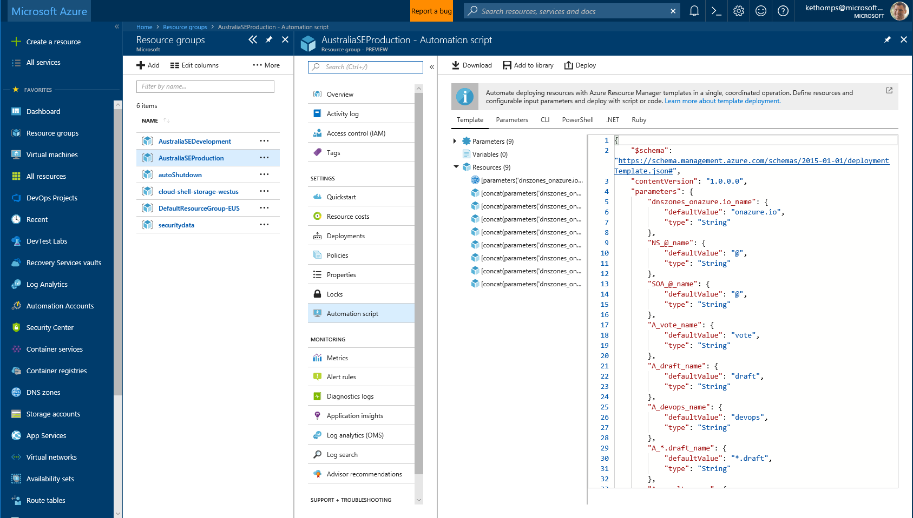
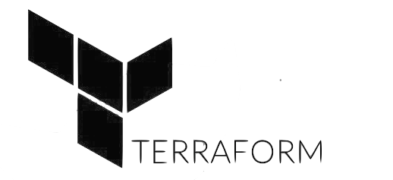

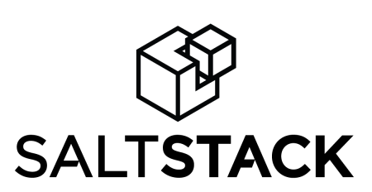
Infrastructure and Configuration as Code
Azure Resource Manager, Automation & 3rd Party Integrations
Infrastructure as Code, built-in
Azure Config & Automation
Support for 3rd party and OSS tooling such as Terraform, Ansible, Chef, Puppet & SaltStack
Notes:
Deploy repeatedly & reliably using Infrastructure as Code
Azure Resource Manager provides these capabilities for Azure out of the box, and works across Azure as well as Azure Stack
But if you’re already using 3rd party tools such as Terraform, Ansible, Chef, Puppet or SaltStack – we support those too!

Slide 23
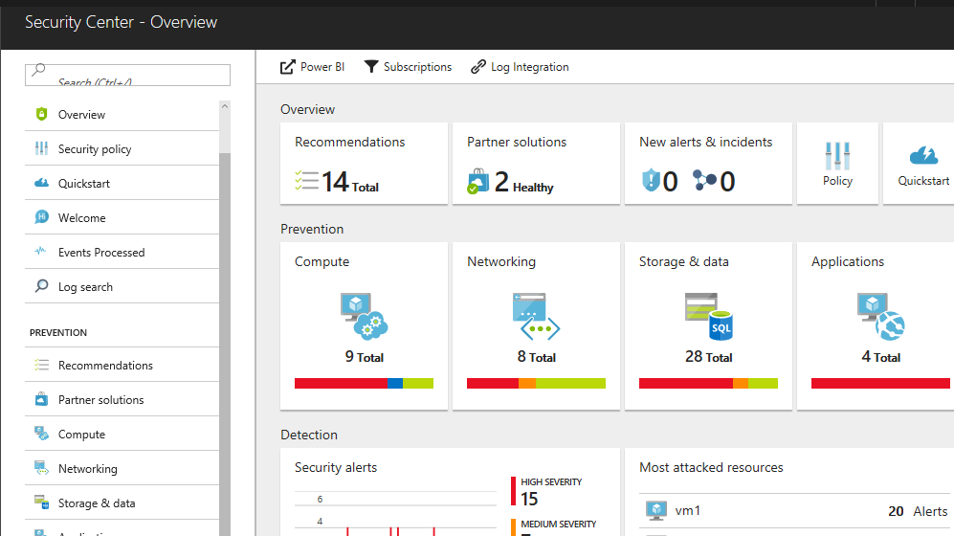
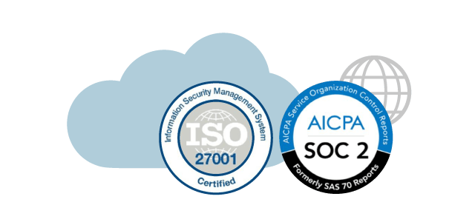
Continuous Security
Azure Security Center
Gain full visibility and control of your cloud security state
Leverage ML to Proactively identify and mitigate risks to reduce exposure to attacks
Quickly detect and respond to threats with advanced analytics
Notes:
Just because you’re moving fast, doesn’t mean you have to lose control – even if you have some Shadow-Ops happening
Azure security gives you visibility and control of your entire cloud security state
Using analytics to provide pro-active recommendations across both Windows and Linux
Leverage services like Azure Event Viewer also to track access, see who change what and when.
------ (additional product context) ------
Secure your cloud resources with Azure Security Center
With Azure Security Center you can gain full visibility and control of your cloud security state with a single, unified view:
Collect security data from multiple sources: Collect, search, and analyze security data from a variety of sources, including connected partner solutions like network firewalls and other Microsoft services.
Integration with existing security workflows: Access, integrate, and analyze security information using REST APIs to connect existing tools and processes.
Easily onboard cloud resources: Keep pace with rapidly changing cloud workloads. Automatically discover and onboard new resources created in your Azure subscriptions.
Continuous security assessment: monitor the security of virtual machines, networks, and Azure services using hundreds of built-in security assessments or create your own.
Built-in dashboards provide instant insights into security issues that require attention.
Centralized policy management: Ensure compliance with company or regulatory security requirements by centrally managing security policies across all your cloud workloads.
Compliance reporting: Use security data and insights to demonstrate compliance and easily generate evidence for auditors.
(If asked whether Azure Security Center supports hybrid workloads, the answer is yes: manage security across all your hybrid cloud workloads – on-premises, Azure, and other cloud platforms – in one console.)
You can also identify and mitigate risks proactively to reduce your exposure to security threats:
Proactive security assessment: Identify software and configurations that are vulnerable to attack.
Actionable recommendations: Remediate security vulnerabilities before they can be exploited by attackers with prioritized, actionable security recommendations and built-in automation playbooks.
Adaptive application controls: Block malware and other unwanted applications by applying whitelisting recommendations adapted to your specific workloads and powered by machine learning.
Controlled network access: Reduce the network attack surface with just-in-time, controlled access to management ports on Azure VMs, drastically reducing exposure to brute force and other network attacks.
Azure Security Center has robust capabilities to prevent attacks. When threats do happen, Security Center can quickly detect and respond to threats with advanced analytics and Microsoft Intelligent Security Graph.
Industry’s most extensive threat intelligence: Tap into the Microsoft Intelligent Security Graph, which uses trillions of signals from Microsoft services and systems around the globe to identify new and evolving threats.
Advanced threat detection: Use built-in behavioral analytics and machine learning to identify attacks and zero-day exploits. Monitor networks, machines, and cloud services for known attack patterns and post-breach activity.
Prioritized alerts and incidents: Focus on the most critical threats first with prioritized security alerts and incidents that map alerts of different types into a single attack campaign. Create your own custom security alerts as well.
Streamlined investigation: Quickly assess the scope and impact of an attack with a visual, interactive experience. Use predefined or ad hoc queries for deeper exploration of security data.
Contextual threat intelligence: Visualize the source of attacks on an interactive world map. Use built-in threat intelligence reports to gain valuable insight into the techniques and objectives of known malicious actors.
At Microsoft, we analyze 300 billion user authentications and check 200 billion emails for spam and malware monthly. We also have unprecedented visibility into cloud infrastructure choices, platforms and the activity therein. Such visibility has no precedent in the on-premises world.

Slide 24
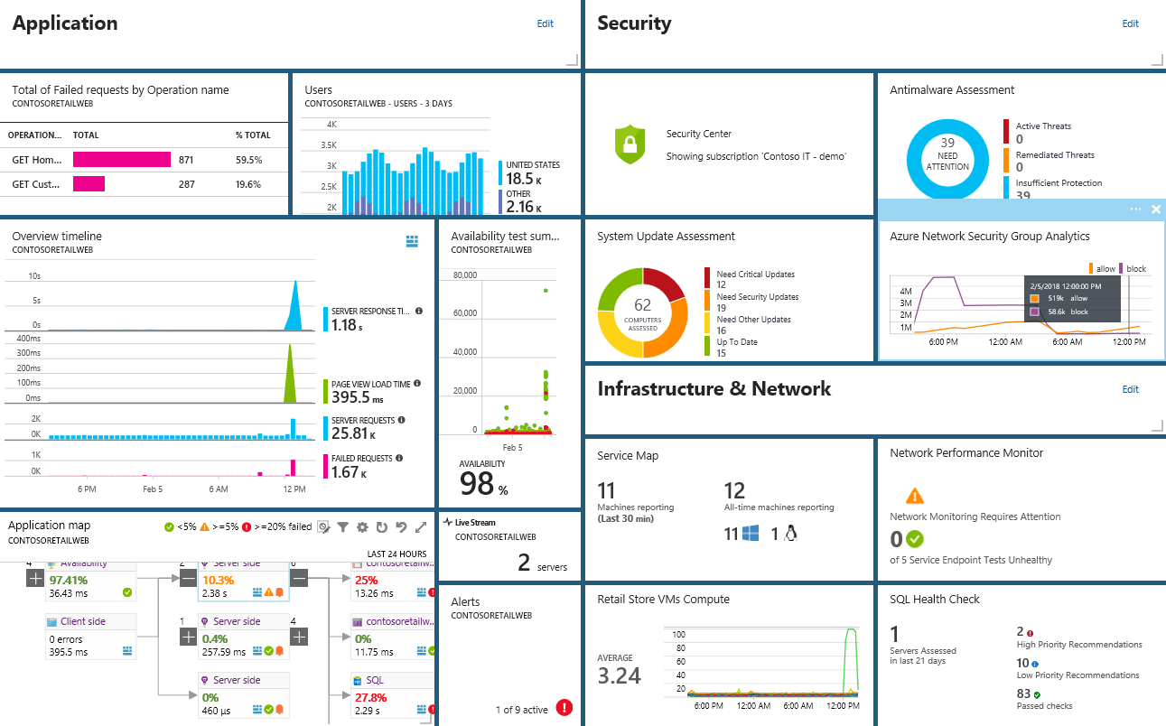
Smarter Insights, Faster
Azure Monitor, Application Insights & Log Analytics
Pre-defined solutions with smart thresholds
Visualize data in intuitive and customizable dashboards
Separate the signal from the noise and accelerate root-cause analysis
Integrate your existing processes & tools like Service Now
Notes:
Azure’s monitoring solutions provide pre-defined solutions with smart thresholds and intuitive dashboards so you can start getting insights straight away
Azure Monitor provides metrics for all Azure infrastructure, building upon that you can leverage both Log Analytics and Application Insights to gain greater insights into your Infrastructure and Applications respectively – leveraging Azure to simplify this into standardized dashboards for both your Developer and your Operations teams
Spend less time separating the signal from the noise and accelerate you root cause analysis
You can also automate and integrate into your existing service desk platforms such as Service Now
------ (additional product context) ------
Monitor your cloud health with Log Analytics
Collect and store your data from any source
Easily collect, store, and analyze your systems and operational data from any source, both on-premises and in the cloud.
Collect data from a wide range of sources including virtual machines, storage accounts, activity logs, Windows, Linux Servers, Java, .NET, legacy and modern apps.
Centrally store activity logs, network logs, infrastructure metrics, app data points, diagnostics logs and alerts.
Gain deep operational insights
Understand CPU disk and memory utilization for your virtual machines.
Get a comprehensive view of applications and network dependencies across multiple virtual machines to perform root-cause analysis more quickly.
Track configuration changes, system updates, and malware status to improve security & compliance.
Visualize data in intuitive and customizable dashboards.
Find the information you need quickly using interactive queries and full-text search.
Detect, diagnose and fix issues quickly
Get notifications and alerts with rich diagnostic information so you can always stay on top of the issues.
Separate the signal from the noise and accelerate root-cause analysis across platforms using advanced analytics including machine learning algorithms.
Automate the implementation of recommended fixes so you can address issues quickly.
Integrate with customer service systems such as your ticketing tool to speed up implementation of fixes.

Slide 25




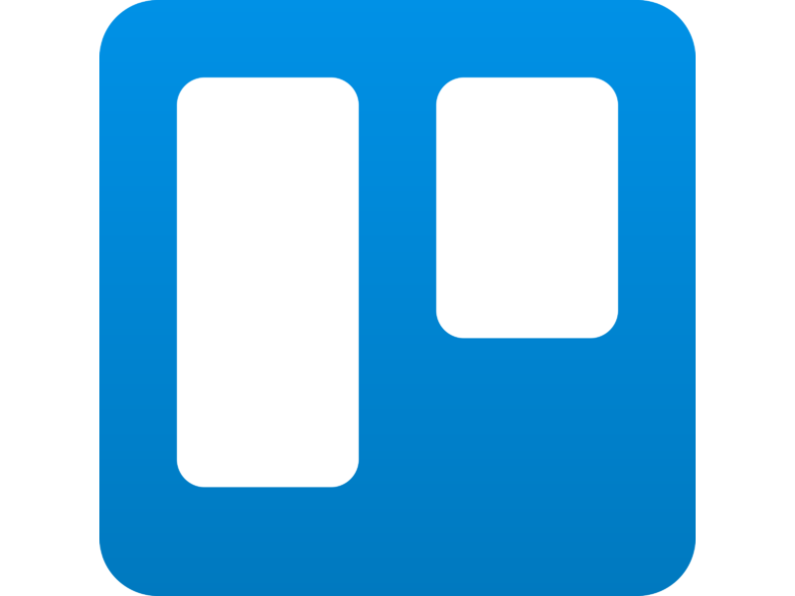
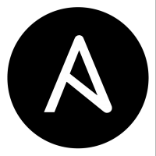

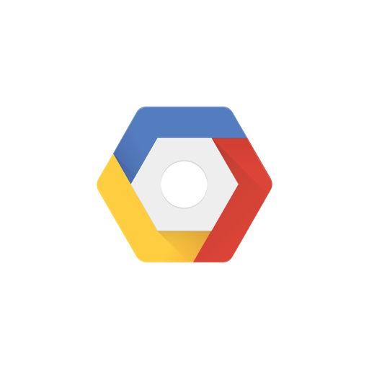
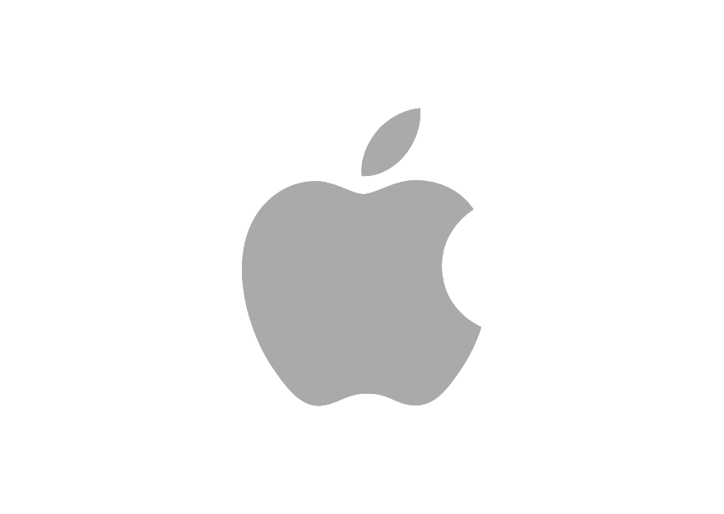
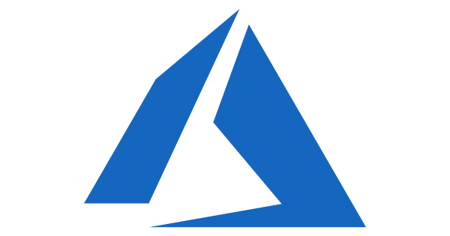


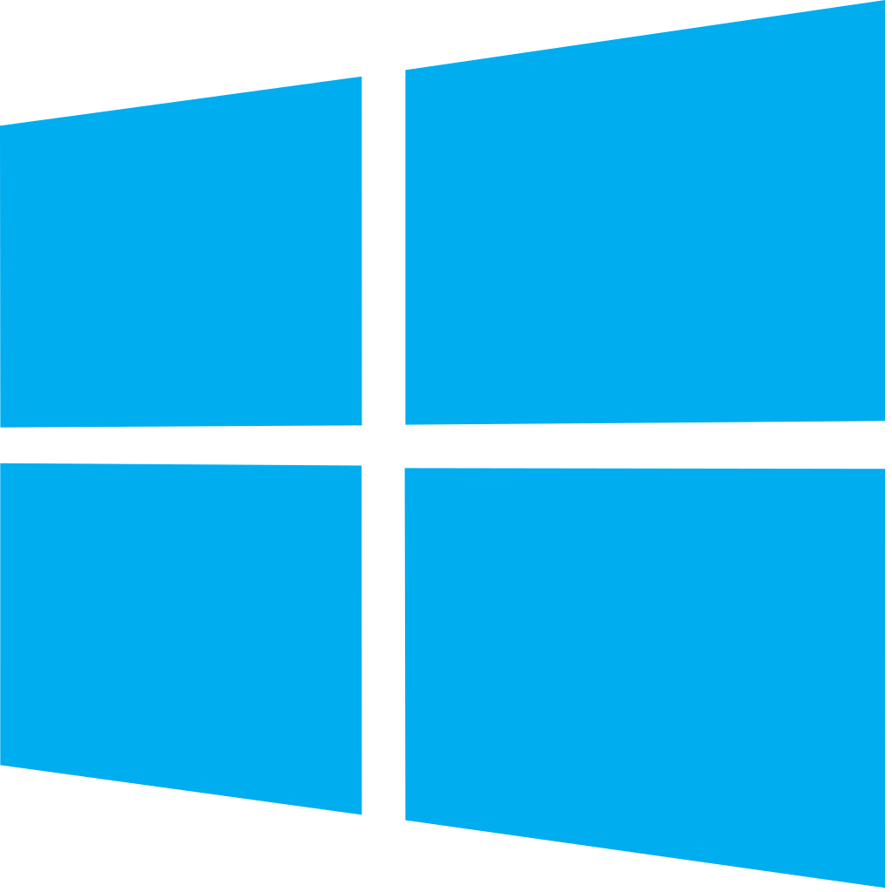


Azure DevOps: Choose the tools and clouds you love
Azure DevOps lets developers choose the tools that are right for them
Mix and match to create workflows with tools from Microsoft, open source or your favorite 3rd party tools
Target any cloud, on-prem or both and deploy to the servers you need

Slide 26




Azure DevOps supports small teams to largest enterprises
Instead of telling people to wait for 6 months for a new feature, we can give it to them in a few weeks…Our 2800 worldwide developers can use the same backlog, user stories and tests whether they’re on Windows or Linux… building for iOS or Android.
Speed is gained in moving to the PaaS offering of Azure DevOps. PaaS provides regularly released features and a future-proof capability, eliminating the need for Accenture to maintain infrastructure and go through upgrade cycles.
“
“
”
”
Microsoft made it really easy to break outside the silos… and tie the DevOps process into the fulfilment of business process. Without the tools that we have today, we would not be successful.
Branches sync 500 percent faster. Builds are 400 percent faster, with the typically six-hour process reduced to 90 minutes. We (now have) a highly streamlined process that operates with a few button clicks—and one-button deployment.
“
“
”
”

Slide 27
DevOps at Microsoft
Azure DevOps is the toolchain of choice for Microsoft engineering with over 90,000 internal users
➔
https://aka.ms/DevOpsAtMicrosoft
372k
Pull Requests per month
4.4m
Builds per month
5m
Work items viewed per day
78,000
Deployments per day
2m
Git commits per month
500m Test executions per day
500k
Work items updated per day
Data: Internal Microsoft engineering system activity, August 2018
Notes:
Enterprise scale

Slide 28
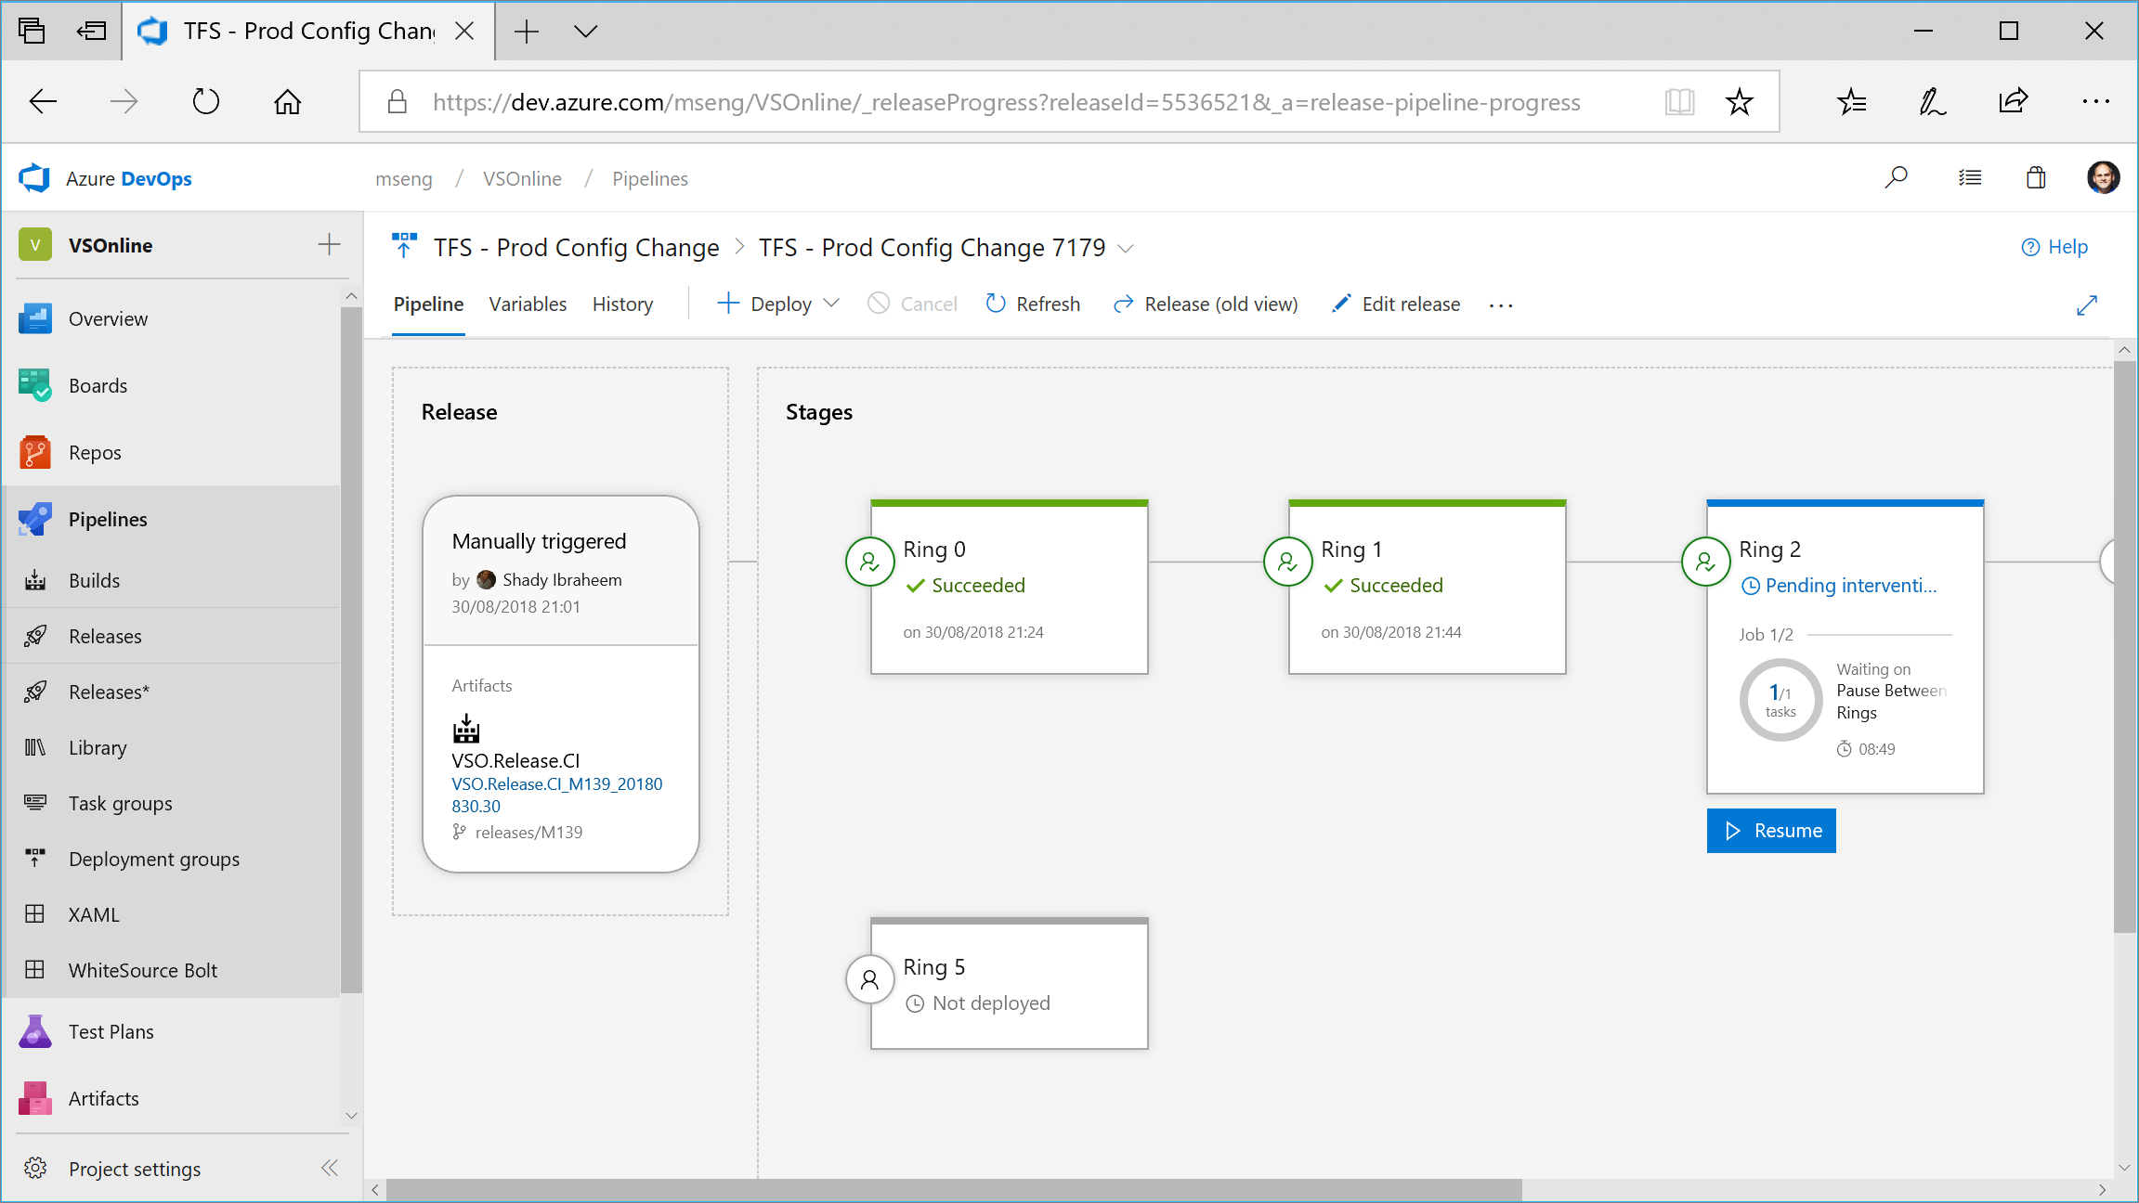

Slide 29
Changes for existing VSTS / TFS customers
The same functionality you know and love today, with greater openness, flexibility and focus
Existing Accounts
Existing https://contoso.visualstudio.com URL continues to work. https://dev.azure.com/contoso available for opt-in.
New UI opt-in per user as preview feature. Will start advertising new UI once feedback from new accounts and early adopters has been incorporated.
Can disable services on a per project basis for new UI
New Azure branding in communications and documentation (emails, alerts etc).
Websites and documentation will move from Visual Studio to Azure based locations (with redirects in place).
Redirects available for some time.
TFS will remain the on-premises brand until the next major version in 2019. The new UI will be enabled in that release.
Existing TFS branded information and downloads remain in Visual Studio locations until next release.
Pricing
Public project usage is now free.
The free tier for Pipelines now includes 1,800 minutes per month, up from 240.
Pipelines can be used independently from Repos — so if you are only using Pipelines and your repos are hosted on GitHub you don’t need to pay for Repos or Boards (Basic) users.
New Accounts
https://dev.azure.com/contoso based URL.
New navigation & branding by default.
Notes:
The functionality you know and love today remains and will continue to be actively expanded on at the same rapid cadence as you are used to. The services will get even more open and extensible with more choice to your workflows. You will be able to move to the new UI when it works for you and your team
Existing Accounts
https://myorg.visualstudio.com continues to work but new https://dev.azure.com/myOrg address also available for opt-in.
New UI opt-in per user. Will start advertising new UI once feedback from new accounts and early adopters has been incorporated.
Can disable services on a per project basis
New Azure branding in communications and documentation (emails, alerts etc).
Websites and documentation will move from Visual Studio to Azure based locations (with redirects in place).
Redirects available for some time.
TFS will remain the on-premises brand until we ship the next major version in 2019. Existing TFS branded information and downloads remain in Visual Studio locations until next release. The new UI will be available in that release.
Pricing
A few key changes:
Public project usage is free.
The free tier for Pipelines now includes 1,800 minutes per month, up from 240.
Pipelines can be used independently from Repos—so if your repos are hosted on GitHub you don’t need to pay for Repos & Boards (Basic) for your users.
New Accounts
https://dev.azure.com/myOrg based URL.
New UI by default.

Slide 30
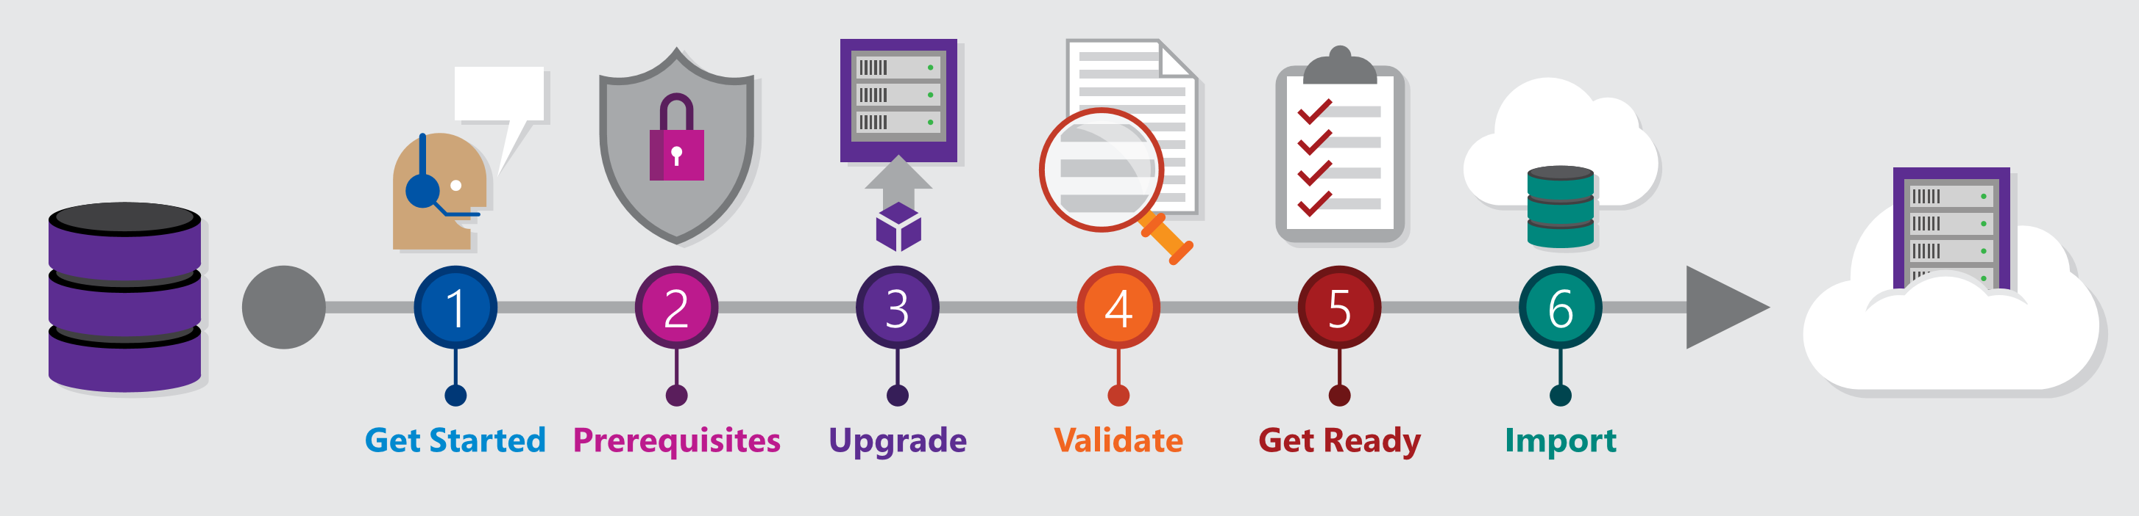
Migrating from TFS to Azure DevOps
Move from Team Foundation Server to Azure DevOps and bring your data along
Benefits of Cloud Hosted Azure DevOps Services
Global availability
Hosted and maintained by Microsoft with 99.9% uptime guarantee and 24x7 support
Immediate access to latest features
Simplified deployment to Azure
TFS Import Service
Fully supported high fidelity migration path
Trusted by many large enterprises
Now faster and easier to use
➔
https://aka.ms/tfsimport

Slide 31





Azure DevOps
Plan smarter, collaborate better, and ship faster with a set of modern dev services
Any developer, any platform, any cloud. Full support for hybrid cloud, on-premises & containers.
Use all the Azure DevOps services or choose just what you need to complement your existing workflows
Best in class builds for open source. Free unlimited build minutes for public projects and up to 10 free concurrent jobs across Windows, Linux and macOS
Get started for free for small teams, scales to support the largest enterprises
Azure Boards
Azure Repos
Azure Pipelines
Azure Test Plans
Azure Artifacts
Start free today
➔
https://azure.com/devops

Slide 32
Azure DevOps Services Pricing
Open Source Projects
Small Teams
Teams of any size
Free
Unlimited users and build time
Azure Pipelines: 10 parallel jobs with unlimited minutes for CI/CD
Azure Boards: Work item tracking and Kanban boards
Azure Repos: Unlimited public Git repos
Free
Start free with up to 5 users
Azure Pipelines: Run 1 Microsoft-hosted job for 1,800 minutes per month and 1 self-hosted job for any amount of time
Azure Boards: Work item tracking and Kanban boards
Azure Repos: Unlimited public Git repos
Azure Artifacts: package management
Unlimited stakeholders
Starts at $6 per user, per month for Boards & Repos*
Easy pricing that grows with your team
Azure Pipelines: Run 1 Microsoft-hosted job for 1,800 minutes per month and 1 self-hosted job for any amount of time
Azure Boards: Work item tracking and Kanban boards
Azure Repos: Unlimited public Git repos
Azure Artifacts: package management
Unlimited stakeholders
Boards & Repos included for Visual Studio subscribers
*
https://azure.com/pricing/details/devops/
5 Boards & Repos users and 5 Artifacts users free. Pipelines with unlimited minutes, Test Plans users and additional Artifacts users also available. Please see the Azure pricing calculator for details.
➔

Slide 33

Thank You

Slide 35
Deck Resources
Azure DevOps PowerPoint Template
Spare Slides
Fonts
Brand Colors
Common Icons (SVG format)

Slide 36
How Microsoft can help
Microsoft Azure is a powerful and flexible foundation for past, present, and future apps – easily build, manage, and deploy any application and any stack on a massive, global network using your favorite tools and frameworks.
Flexible
Powerful
Open
Choice of IaaS, PaaS, public cloud or hybrid.
Mirror or modernize app infrastructure with VMs, containers, microservices or serverless.
Supports all stages of the app modernization journey – from lift-and-shift to Cloud-Native.
Instantly improve the performance, scalability and resiliency of your apps by moving them to the cloud.
Increase business agility with Cloud-Native capabilities and built-in DevOps for continuous innovation.
Bring your stack, we bring a cloud that runs any app, on any platform, and any language.
Build applications using the language and tools of your choice - Azure supports what you already use and love so you can get up and running fast – just bring code.

Slide 37
What technologies do I need to support DevOps?
DevOps brings together people, processes, and technology, automating software delivery to provide continuous value to your users. Using Azure DevOps, you can deliver software faster and more reliably - no matter how big your IT department or what tools you’re using.
Continuous Integration (CI)
Improve software development quality and speed.
When you use Azure Pipelines or Jenkins to build apps in the cloud and deploy to Azure, each time you commit code, it’s automatically built and tested and bugs are detected faster.
Continuous Deployment (CD)
By combining continuous integration and infrastructure as code (IaC), you’ll achieve identical deployments and the confidence to deploy to production at any time.
With continuous deployment, you can automate the entire process from code commit to production if your CI/CD tests are successful.
Continuous Learning & Monitoring
With Azure Application Insights you can identify how your applications are performing and test if the recent deployment made things better or worse.
Using CI/CD practices, paired with monitoring tools, you’ll be able to safely deliver features to your customers as soon as they’re ready.

Slide 38
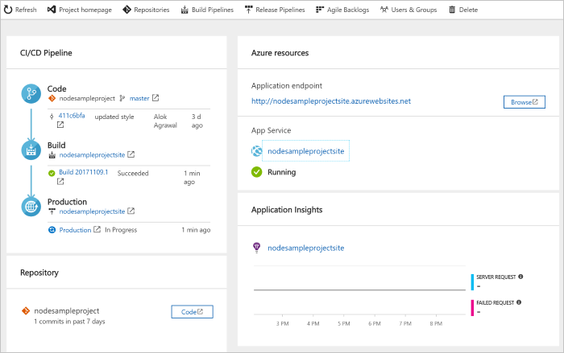
DevOps Pipelines in Minutes
Azure DevOps Projects
Create a full DevOps pipeline with 3 easy steps from the Azure Portal
Start with a Git repo and any source language
Web apps, Kubernates, soon VMs and more.
Customize, extend and scale when needed.
Notes:
Moving from the developer environment, Azure also makes deploying, or integrating existing, DevOps pipelines as fast as possible
Azure DevOps Projects is the quickest way to get started with DevOps on Azure for people who know about DevOps but are just starting or want a quick way to create a basic pipeline to play with or build upon.
DevOps projects creates a basic, complete CI/CD pipeline in Azure which can later be extended and customized outside in Azure Pipelines
Although DevOps Projects builds a DevOps pipeline on Azure it allows for any easy “Getting started” experience with Azure Pipelines which can then be applied to hybrid and on-prem scenarios with Azure Pipelines which can target any platform or with Azure DevOps Server which can be installed on prem.

Slide 39


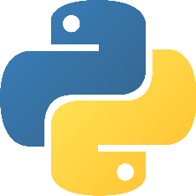

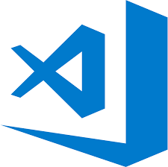
Early adopters
GitHub projects already powered by Azure Pipelines for CI
atom/atom
python/cpython
dotnet/reactive
microsoft/vscode

Slide 40

Device layout
Subhead Segoe UI 28pt
Subhead Segoe UI 28pt
Subhead Segoe UI 28pt
© Microsoft Corporation

Slide 41
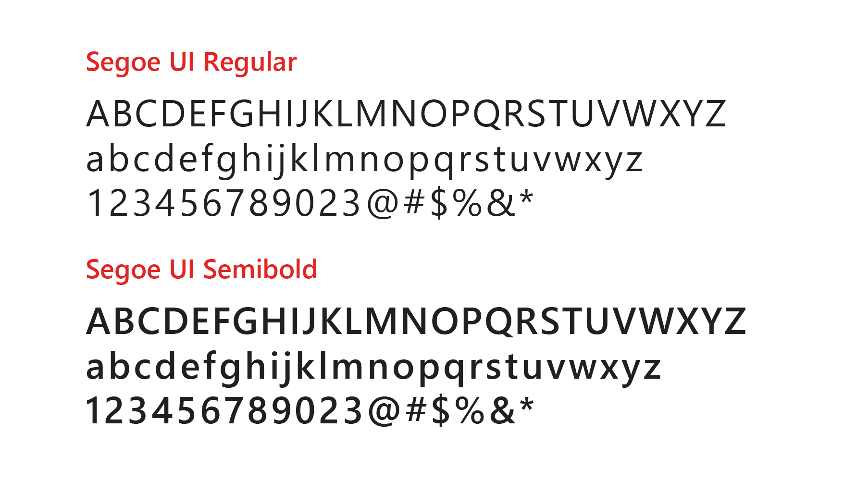
Segoe UI is the font that’s used for on-screen and digital executions
Follow these guidelines for PowerPoint
Size and weight
Limit type to no more than three sizes on a slide.
Use Semibold for text larger than 28pt.
Use Regular for increased legibility at small sizes or over backgrounds.
Use Semibold for subheads and headlines.
Segoe Black, Light and Condensed should not be used.
Case
Sentence case is our standard for all communications.
Use all-uppercase sparingly – for titles, short headings, or subheadings, and never for full paragraphs.
Don’t use all-lowercase type.
Justification
Type should be set flush left, ragged right. Avoid windows, orphans and lines that end with hyphens.

Slide 42
Azure brand colors
Digital and on-screen applications use RGB or HEX color formulas. The color formulas are shown below.
Azure blue — a classic member of the Microsoft family of colors.
Azure Blue
R0 G120 B215 0078D7
Medium Blue
R77 G176 B255 4DB0FF
Light Blue
R177 G214 B242 B1D6F2
Chart Colors
R3 G90 B160
035AA0
R0 G120 B215
0078D7
R77 G176 B255 4DB0FF
R148 G208 B255 94D0FF
R177 G214 B242 B1D6F2

Slide 43
Azure DevOps colors
Digital and on-screen applications use RGB or HEX color formulas. The color formulas are shown below.
Azure Blue
R0 G120 B215 0078D7
Service Colors
R0 G178 B148
00B294
Boards
R216 G59 B1
D83B01
Repos
R37 G96 B224 2560E0
Pipelines
R133 G76 B199 854CC7
Test Plans
R203 G46 B109 CB2E6D
Artifacts

Slide 44
Colors and Accessibility
Type and background combinations must meet a minimum 4.5:1 contrast ratio or greater for accessibility. Examples below demonstrate correct color use for on-screen applications. Colors shown with notched corners require black/dark text to be accessible.
Light Yellow
R255 G241 B0
FFF100
Light Orange
R255 G140 B0
FF8C00
Light Magenta
R227 G0 B140
E3008C
Light Purple
R180 G160 B255
B4A0FF
Light Blue
R0 G188 B242
00BCF2
Light Teal
R0 G178 B148
00B294
Light Green
R186 G216 B10
BAD80A
Light accent colors
Yellow
R255 G185 B0
FFB900
Orange
R216 G59 B1
D83B01
Red
R232 G17 B35
E81123
Magenta
R180 G0 B158
B4009E
Purple
R92 G45 B145
5C2D91
Blue
R0 G120 B215
0078D7
Teal
R0 G130 B114
008272
Green
R16 G124 B16
107C10
Microsoft 8 brand colors
Dark Red
R168 G0 B0
A80000
Dark Magenta
R92 G0 B92
5C005C
Dark Purple
R50 G20 B90
32145A
Dark Blue
R0 G32 B80
002050
Dark Teal
R0 G75 B80
004B50
Dark Green
R0 G75 B28
004B1C
Dark accent colors (+ one mid accent color)
Mid Blue
R0 G24 B143
00188F
For more information on accessibility, visit: Microsoft.com/enable
White
R255 G255 B255
FFFFFF
Light Gray
R210 G210 B210
D2D2D2
Mid Gray
R115 G115 B115
737373
Dark Gray
R80 G80 B80
505050
Rich Black
R0 G0 B0
000000
White, black and gray accent colors

Slide 45

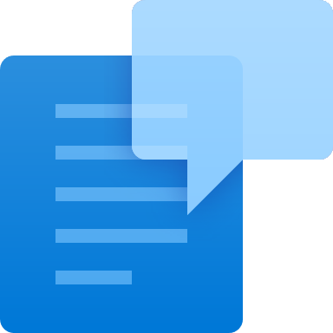
Azure DevOps Branding Guidelines
Our umbrella suite name is Azure DevOps.
We will use Azure DevOps Services & Azure DevOps Server to disambiguate between the cloud & on-premise versions (i.e. formerly VSTS & TFS) but where possible just use Azure DevOps as the umbrella term to refer to both.
No abbreviations should be used (especially not ADS). Azure DevOps or #AzureDevOps are the only permitted forms. DevOps should always be PascalCase.
While Azure DevOps is the term for the encompassing suite, emphasis should be placed on the core service being referred to, i.e "Build and Release to Any Cloud, Any Platform with Azure Pipelines".
There is no need to prefix with Microsoft for the name, (i.e. you do not need to say Microsoft Azure Pipelines). There are no trademark symbols required.
While the focus for Azure Repos will be Git version control, the centralized version control system it supports is still referred to as TFVC and the command line for it remains tf
Suite Icon for launch will remain the same as the VSTS Icon. However, as per corporate guidelines we will not be using the icon prominently in swag, stickers and launch materials. Instead focusing on the Microsoft and Azure brands.
Backlinks
When referencing Azure DevOps or an Azure DevOps service in the web then try to ensure the first reference in the content body of the page is back-linked to the appropriate landing page (see table below). In articles that historically mention VSTS or TFS then please link to the main landing page for Azure DevOps.
Area | Destination URL
Azure DevOps | https://azure.microsoft.com/services/devops/
Azure Pipelines | https://azure.microsoft.com/services/devops/pipelines/
Azure Boards | https://azure.microsoft.com/services/devops/boards/
Azure Repos | https://azure.microsoft.com/services/devops/repos/
Azure Artifacts | https://azure.microsoft.com/services/devops/artifacts/
Azure Test Plans | https://azure.microsoft.com/services/devops/test-plans/

Slide 46
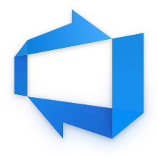
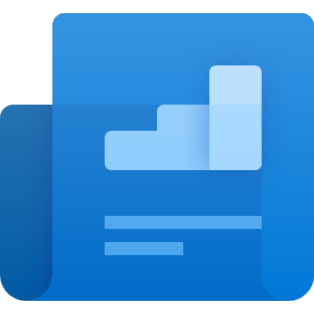

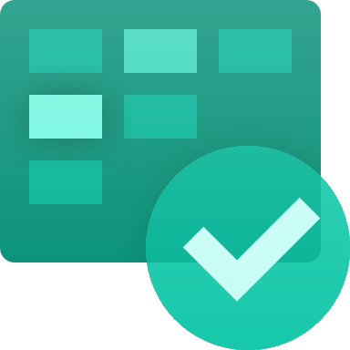
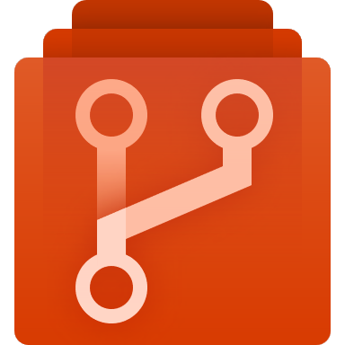

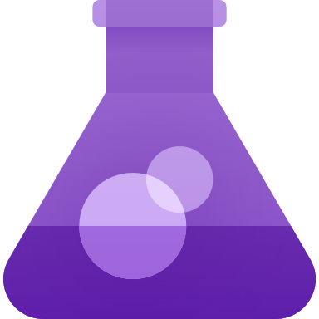
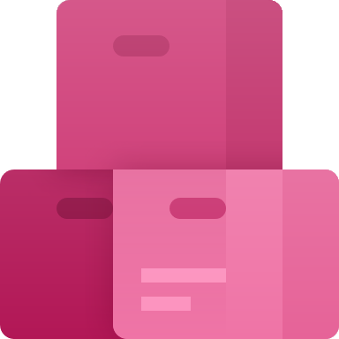
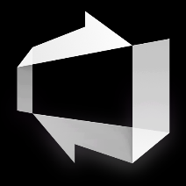

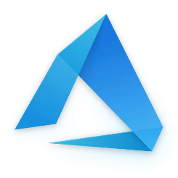

Azure DevOps Icons
Azure DevOps (Preferred) | Azure DevOps Shaded |  | Overview | Wiki | Azure DevOps White Flat
Azure Boards | Azure Repos | Azure Pipelines | Azure Test Plans | Azure Artifacts | Azure DevOps White Shaded
Azure | Azure (Shaded) |  |  |  | Azure

Slide 47
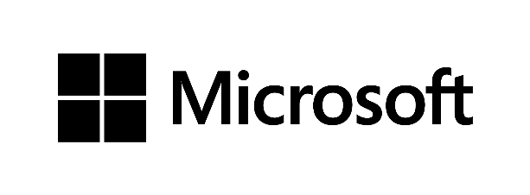
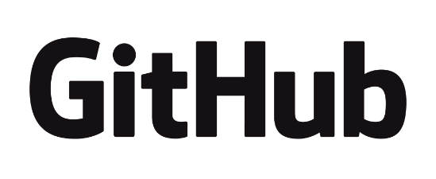

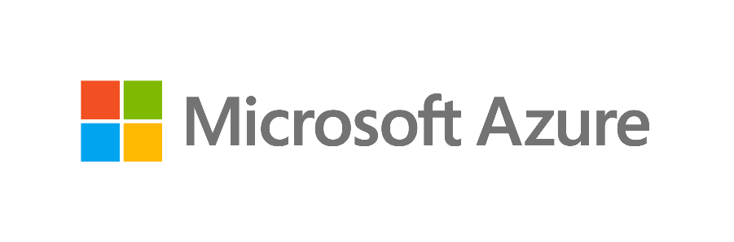
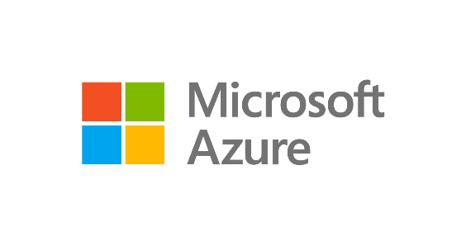
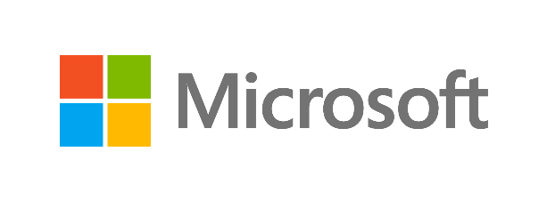
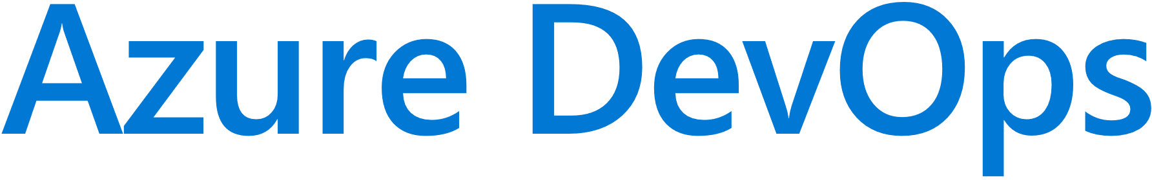








Logos and Wordmarks

Slide 48









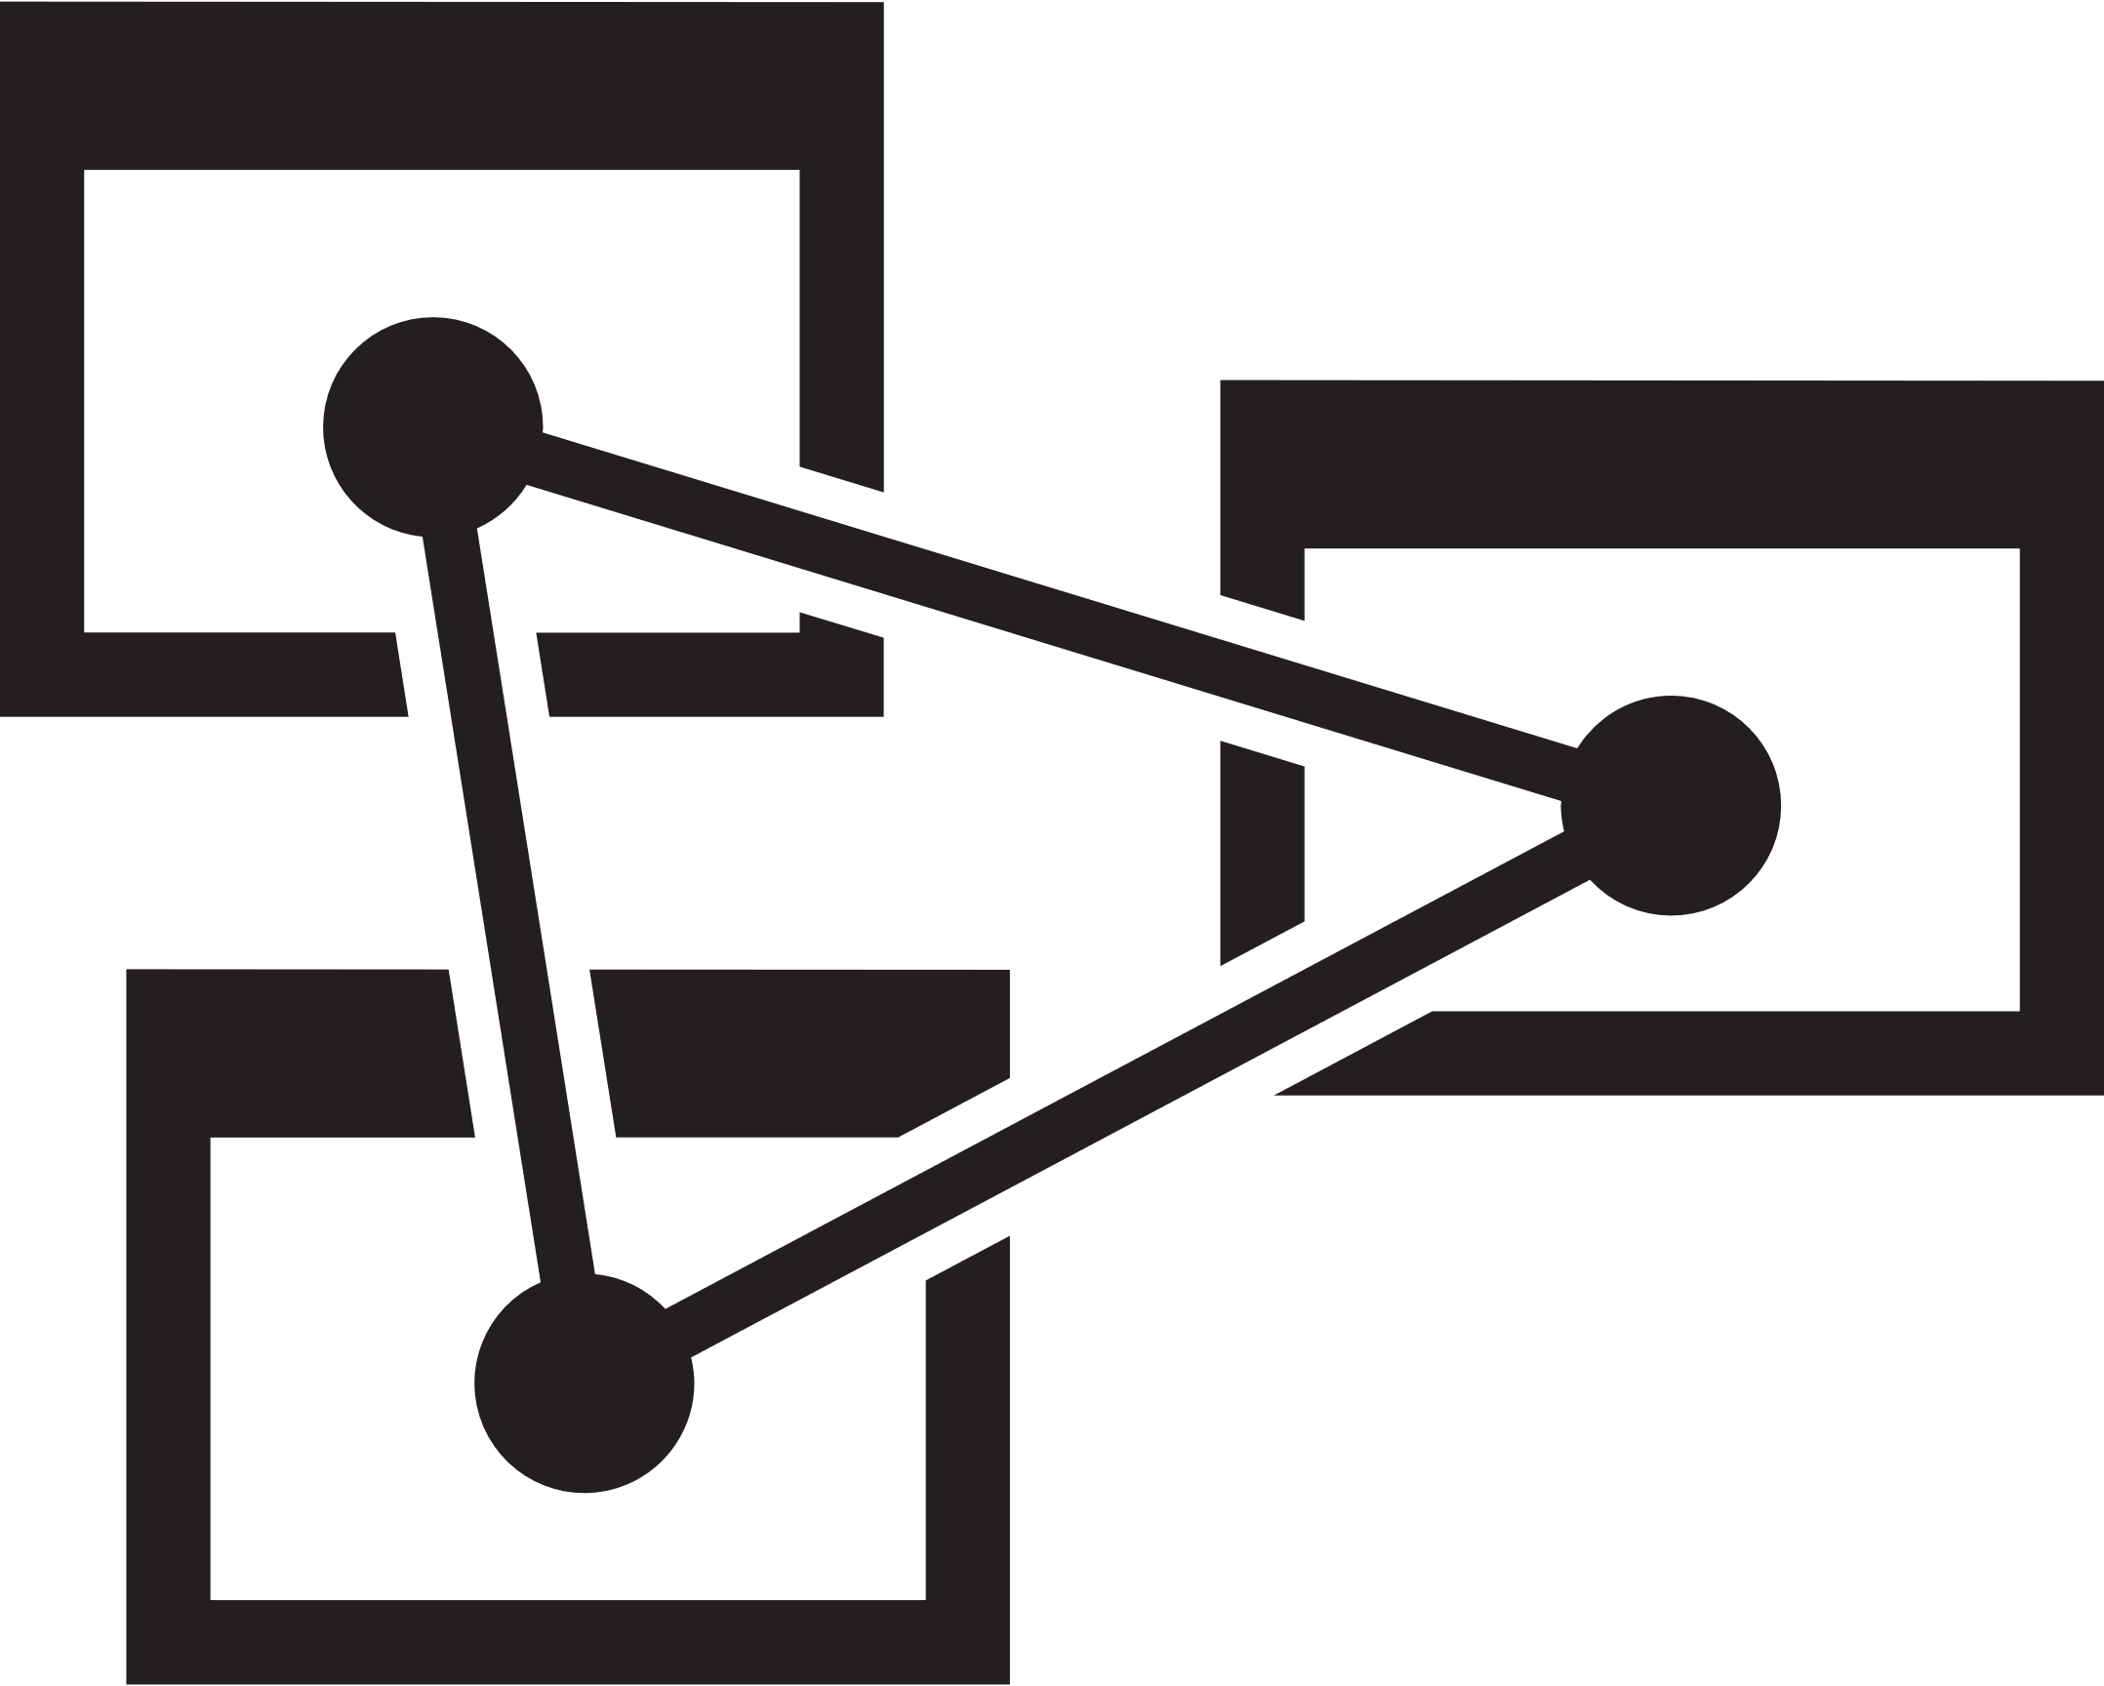














ICON SVGs
API Apps | API Management | App Service | Applications Gateway | Application Insights | Automation
Azure | Azure Active Directory | Azure Advisor | Azure Analysis Services | Azure Backup | Azure Bot Services
Azure Cache Redis Product Icon | Azure Container Registry | Azure Container Service ACS & AKS | Azure Content Delivery Network | Azure Database for PostgreSQL | Azure Database Migration Service
Azure DDoS Protection | Azure DevTest Labs | Azure DNS | Azure Event Grid | Azure Functions | Azure Media Player

Slide 49
























ICON SVGs
Azure Monitor | Azure MySQL ClearDB Database | Azure Policy | Azure SDK | Azure Search | Azure Service Health
Azure SQL Data Warehouse | Azure SQL Database | Azure Virtual Machines | Azure Virtual Network | Backup Online | Batch
Blob Storage | Blockchain | Bug | Cloud | Cloud Services | Cloud Shell
Cognitive Services | Content Protection | Cosmos DB | Data Catalog | Data Factory | Database Generic

Slide 50
























ICON SVGs
Encoding | Event Hubs | Express Route | File Storage | Game Controller | Gears
HD Insight | IoT Hub | Key Vault | Kubernetes | Linux Virtual Mach. | Windows Virtual Mach.
Linux Penguin | Live + On-Demand Streaming | Load Balancer | Load Balancer (Generic) | Logic Apps | Machine Learning Studio
Maintenance | Media Services | Mobile Apps | Multi-Factor Authentication | Network Watcher | Notification Hubs

Slide 51
























ICON SVGs
OMS Log Analytics | Power BL | PowerShell Script File | Queue Storage | Resource Group | Scheduler
Script File | Security Center | Server Farm | Server Rack | Server Bus | Service Fabric
Site Recovery | Smartcard | SQL Server Switch Database | Status Badge – Cancelled | Status Badge – Critical | Status Badge – Info
Status Badge – Success | Status Badge – Warning | Storage | StorSimple | Stream Analytics | Table Storage

Slide 52










ICON SVGs
Tasks | Time Series Insights | Traffic Manager | Video | Visual Studio | VS Code
VPN Gateway | Web | Web Apps | XML Web Services

Slide 53
World map

Slide 54
Additional resources
Additional Azure-related elements from across Microsoft (may require Corpnet access)
Branding
Brand Central
C+E Brand Guidelines
Brand Architecture at Microsoft
Style Guides
Microsoft Cloud Style Guide
Azure DevOps Branding Guide
PowerPoint templates
C+E branded template
Azure branded template
APEX | CDA branded template
Iconography
C+E Icon set

